Slide 1
Linked List
CS201
CS201
Data Structures
‹#›
Notes:
‹#›

Slide 2
Introduction
A linked list is a data structure which can change during execution.
Successive elements are connected by pointers.
Last element points to NULL.
It can grow or shrink in size during execution of a program.
It can be made just as long as required.
It does not waste memory space.
head
A
B
C
CS201
Data Structures
‹#›

Slide 3
Keeping track of a linked list:
Must know the pointer to the first element of the list (called start, head, etc.).
Linked lists provide flexibility in allowing the items to be rearranged efficiently.
Insert an element.
Delete an element.
CS201
Data Structures
‹#›

Slide 4
Illustration: Insertion
A
B
C
tmp
X
Item to be inserted
A
A
B
C
curr
X
CS201
Data Structures
‹#›

Slide 5
Pseudo-code for insertion
typedef struct nd {
struct item data;
struct nd * next;
} node;
void insert(node *curr)
{
node * tmp;
tmp=(node *) malloc(sizeof(node));
tmp->next=curr->next;
curr->next=tmp;
}
CS201
Data Structures
‹#›

Slide 6
Illustration: Deletion
Item to be deleted
A
B
C
tmp
curr
A
B
C
CS201
Data Structures
‹#›

Slide 7
Pseudo-code for deletion
typedef struct nd {
struct item data;
struct nd * next;
} node;
void delete(node *curr)
{
node * tmp;
tmp=curr->next;
curr->next=tmp->next;
free(tmp);
}
CS201
Data Structures
‹#›

Slide 8
In essence ...
For insertion:
A record is created holding the new item.
The next pointer of the new record is set to link it to the item which is to follow it in the list.
The next pointer of the item which is to precede it must be modified to point to the new item.
For deletion:
The next pointer of the item immediately preceding the one to be deleted is altered, and made to point to the item following the deleted item.
CS201
Data Structures
‹#›

Slide 9
Array versus Linked Lists
Arrays are suitable for:
Inserting/deleting an element at the end.
Randomly accessing any element.
Searching the list for a particular value.
Linked lists are suitable for:
Inserting an element.
Deleting an element.
Applications where sequential access is required.
In situations where the number of elements cannot be predicted beforehand.
CS201
Data Structures
‹#›

Slide 10
Types of Lists
Depending on the way in which the links are used to maintain adjacency, several different types of linked lists are possible.
Linear singly-linked list (or simply linear list)
One we have discussed so far.
head
A
B
C
CS201
Data Structures
‹#›

Slide 11
Circular linked list
The pointer from the last element in the list points back to the first element.
head
A
B
C
CS201
Data Structures
‹#›

Slide 12
Doubly linked list
Pointers exist between adjacent nodes in both directions.
The list can be traversed either forward or backward.
Usually two pointers are maintained to keep track of the list, head and tail.
head
tail
A
B
C
CS201
Data Structures
‹#›

Slide 13
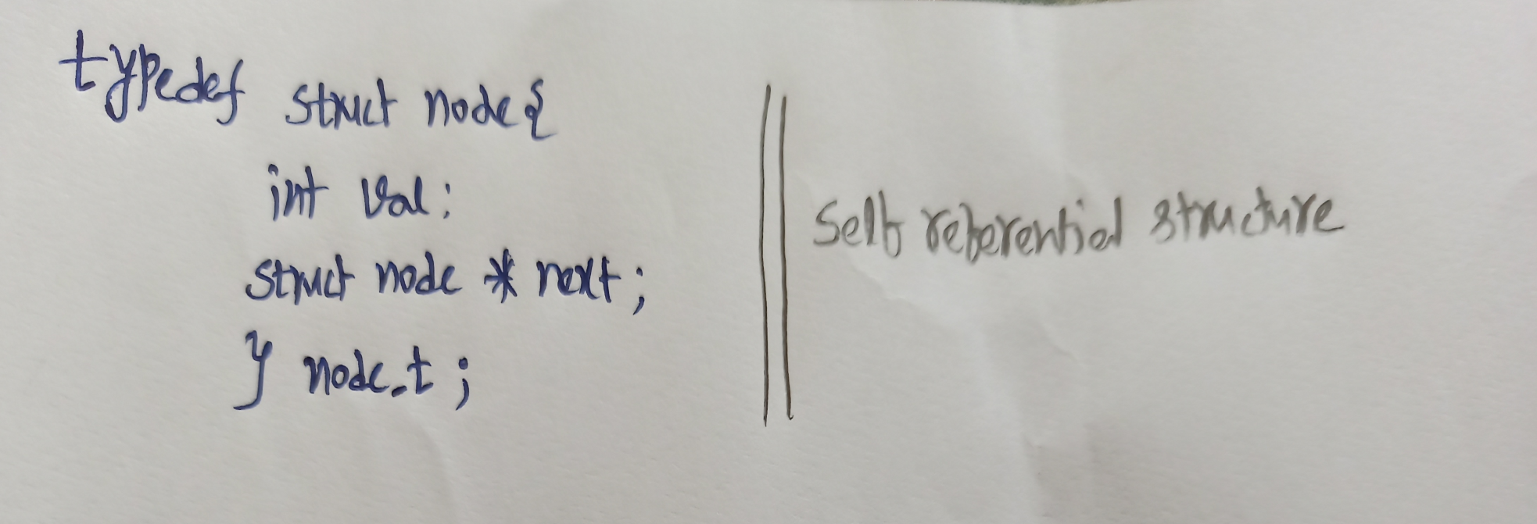
Creating a linked list
Step1: Declaring a node:
CS201
Data Structures
‹#›

Slide 14
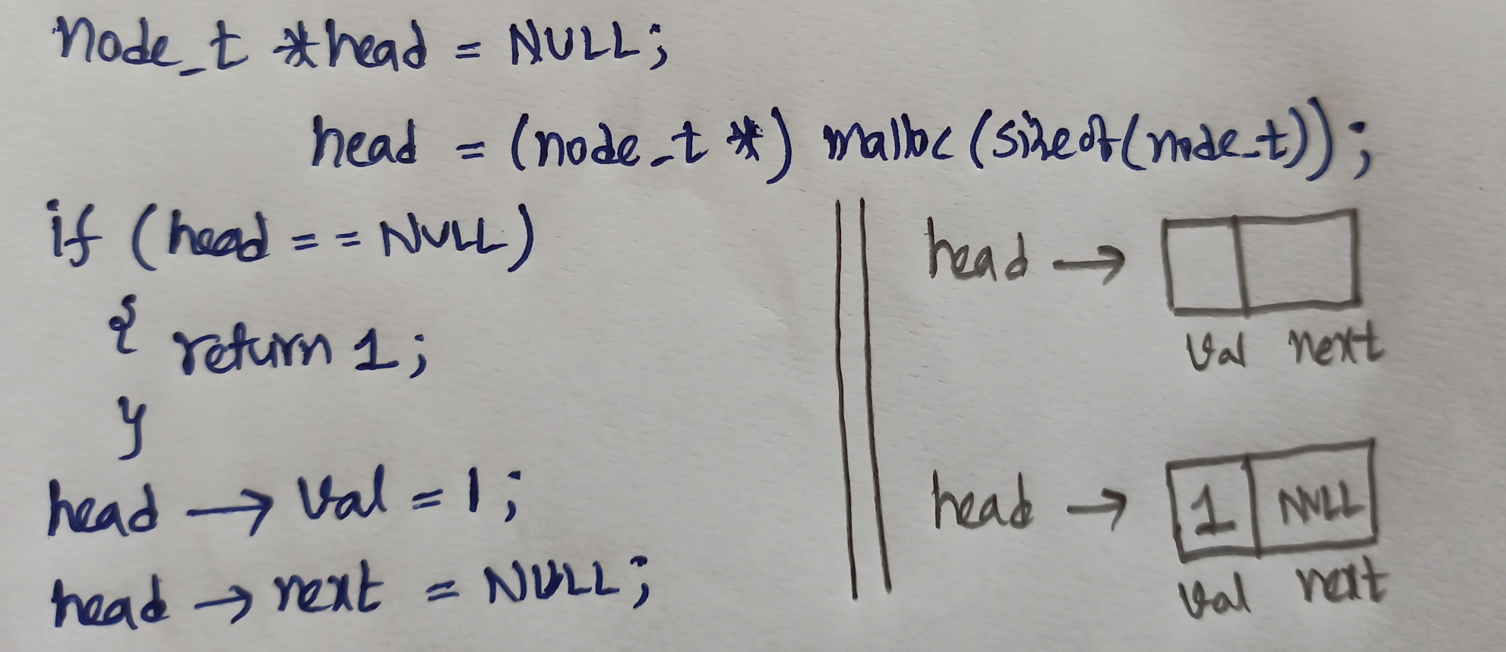
Creating a linked list
Step2: Creating a node:
CS201
Data Structures
‹#›

Slide 15
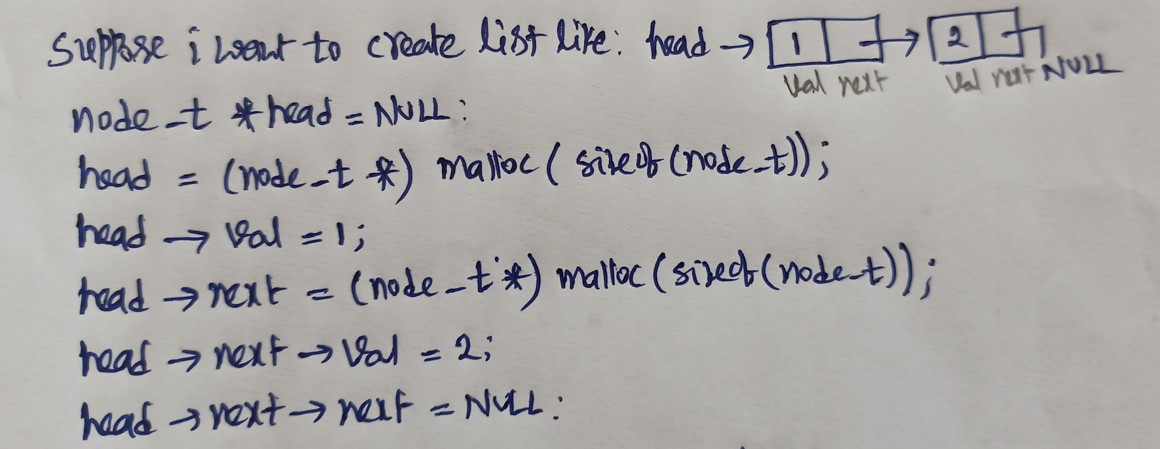
Creating a linked list
CS201
Data Structures
‹#›

Slide 16
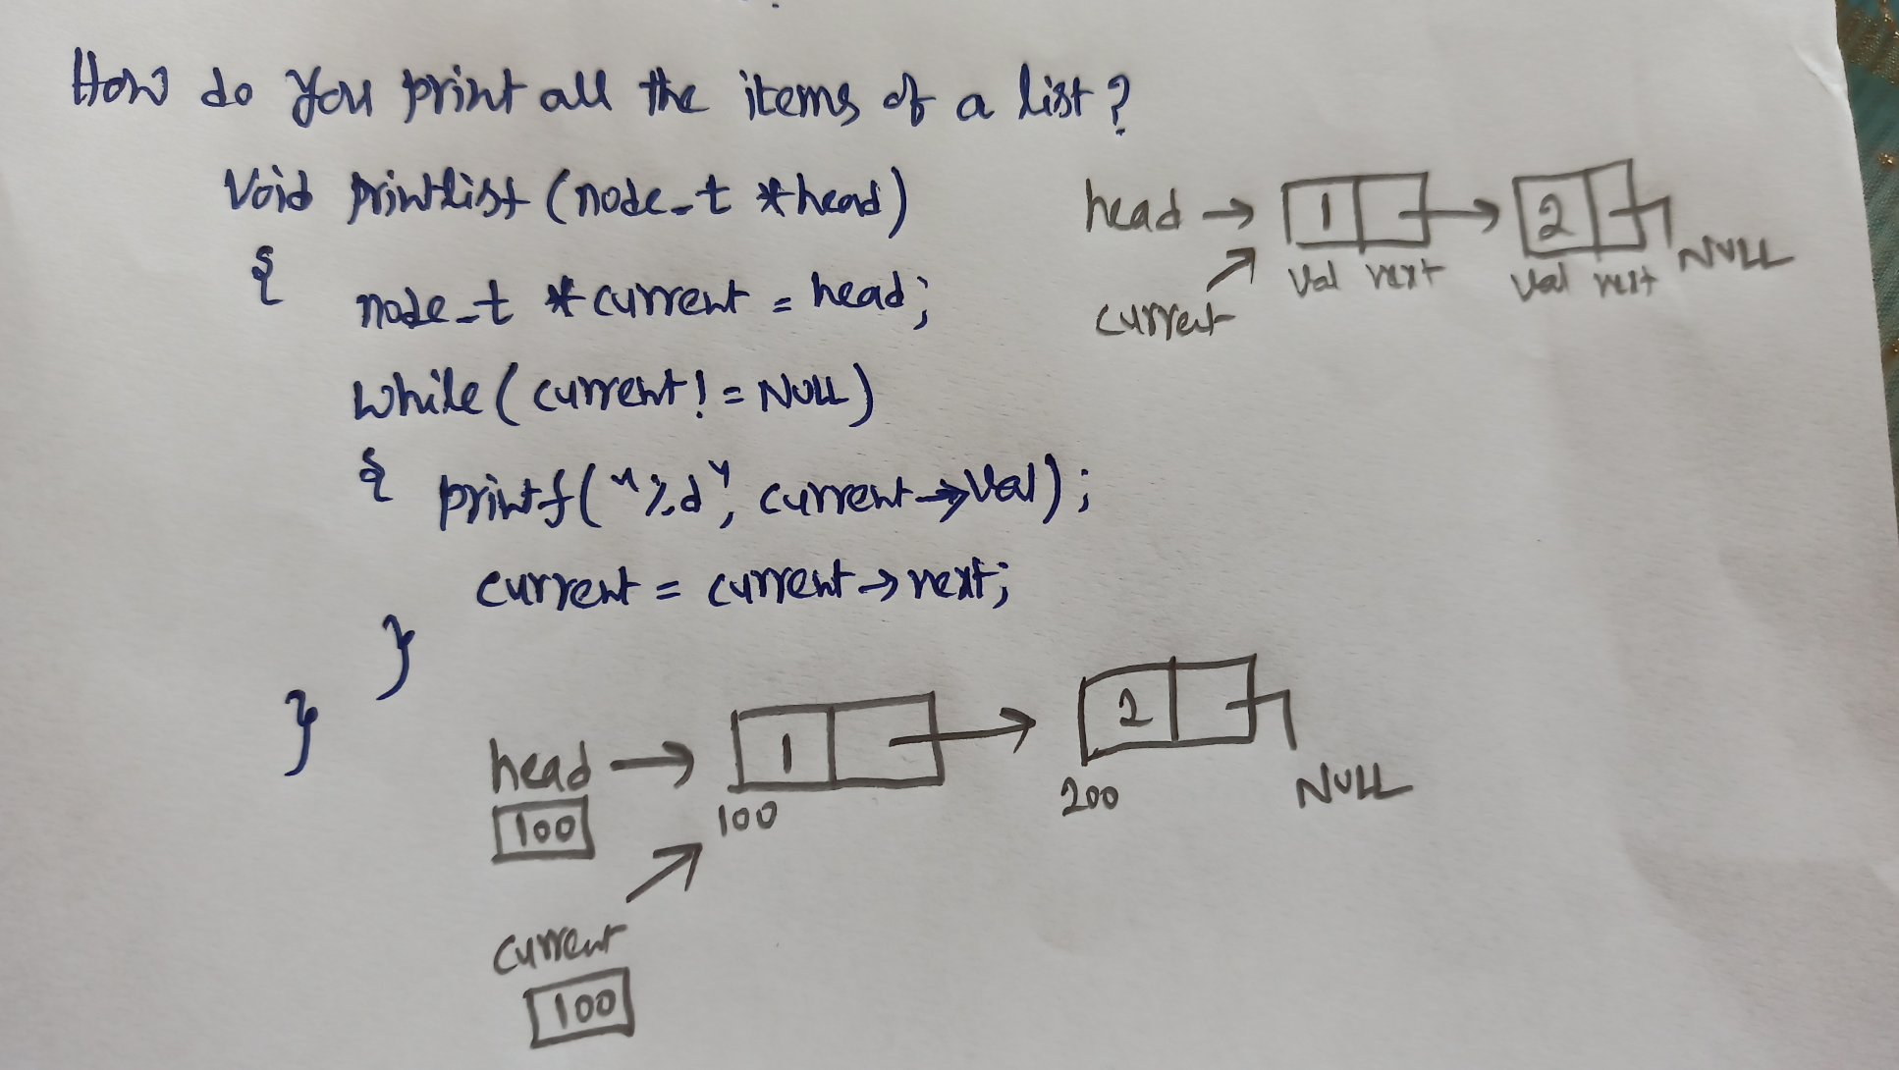
Printing the created list
CS201
Data Structures
‹#›

Slide 17
Basic Operations on a List
Creating a list
Traversing the list
Inserting an item in the list
Deleting an item from the list
Concatenating two lists into one
CS201
Data Structures
‹#›

Slide 18
List is an Abstract Data Type
What is an abstract data type?
It is a data type defined by the user.
Typically more complex than simple data types like int, float, etc.
Why abstract?
Because details of the implementation are hidden.
When you do some operation on the list, say insert an element, you just call a function.
Details of how the list is implemented or how the insert function is written is no longer required.
CS201
Data Structures
‹#›

Slide 19
Conceptual Idea
List
implementation
and the
related functions
Insert
Delete
Traverse
CS201
Data Structures
‹#›

Slide 20
Example: Working with linked list
Consider the structure of a node as follows:
struct stud {
int roll;
char name[25];
int age;
struct stud *next;
};
/* A user-defined data type called “node” */
typedef struct stud node;
node *head;
CS201
Data Structures
‹#›

Slide 21
Creating a List
CS201
Data Structures
‹#›

Slide 22
How to begin?
To start with, we have to create a node (the first node), and make head point to it.
head = (node *) malloc(sizeof(node));
head
roll
name
next
age
CS201
Data Structures
‹#›

Slide 23
Contd.
If there are n number of nodes in the initial linked list:
Allocate n records, one by one.
Read in the fields of the records.
Modify the links of the records so that the chain is formed.
head
A
B
C
CS201
Data Structures
‹#›

Slide 24
node *create_list()
{
int k, n;
node *p, *head;
printf ("\n How many elements to enter?");
scanf ("%d", &n);
for (k=0; k<n; k++)
{
if (k == 0) {
head = (node *) malloc(sizeof(node));
p = head;
}
else {
p->next = (node *) malloc(sizeof(node));
p = p->next;
}
scanf ("%d %s %d", &p->roll, p->name, &p->age);
}
p->next = NULL;
return (head);
}
CS201
Data Structures
‹#›

Slide 25
To be called from main() function as:
node *head;
………
head = create_list();
CS201
Data Structures
‹#›

Slide 26
Traversing the List
CS201
Data Structures
‹#›

Slide 27
What is to be done?
Once the linked list has been constructed and head points to the first node of the list,
Follow the pointers.
Display the contents of the nodes as they are traversed.
Stop when the next pointer points to NULL.
CS201
Data Structures
‹#›

Slide 28
void display (node *head)
{
int count = 1;
node *p;
p = head;
while (p != NULL)
{
printf ("\nNode %d: %d %s %d", count,
p->roll, p->name, p->age);
count++;
p = p->next;
}
printf ("\n");
}
CS201
Data Structures
‹#›

Slide 29
To be called from main() function as:
node *head;
………
display (head);
CS201
Data Structures
‹#›

Slide 30
Inserting a Node in a List
CS201
Data Structures
‹#›

Slide 31
How to do?
The problem is to insert a node before a specified node.
Specified means some value is given for the node (called key).
In this example, we consider it to be roll.
Convention followed:
If the value of roll is given as negative, the node will be inserted at the end of the list.
CS201
Data Structures
‹#›

Slide 32
Contd.
When a node is added at the beginning,
Only one next pointer needs to be modified.
head is made to point to the new node.
New node points to the previously first element.
When a node is added at the end,
Two next pointers need to be modified.
Last node now points to the new node.
New node points to NULL.
When a node is added in the middle,
Two next pointers need to be modified.
Previous node now points to the new node.
New node points to the next node.
CS201
Data Structures
‹#›

Slide 33
void insert (node **head)
{
int k = 0, rno;
node *p, *q, *new;
new = (node *) malloc(sizeof(node));
printf ("\nData to be inserted: ");
scanf ("%d %s %d", &new->roll, new->name, &new->age);
printf ("\nInsert before roll (-ve for end):");
scanf ("%d", &rno);
p = *head;
if (p->roll == rno) /* At the beginning */
{
new->next = p;
*head = new;
}
**m
*m
*m
CS201
Data Structures
‹#›

Slide 34
else
{
while ((p != NULL) && (p->roll != rno))
{
q = p;
p = p->next;
}
if (p == NULL) /* At the end */
{
q->next = new;
new->next = NULL;
}
else if (p->roll == rno)
/* In the middle */
{
q->next = new;
new->next = p;
}
}
}
The pointers
q and p
always point
to consecutive
nodes.
CS201
Data Structures
‹#›

Slide 35
To be called from main() function as:
node *head;
………
insert (&head);
CS201
Data Structures
‹#›

Slide 36
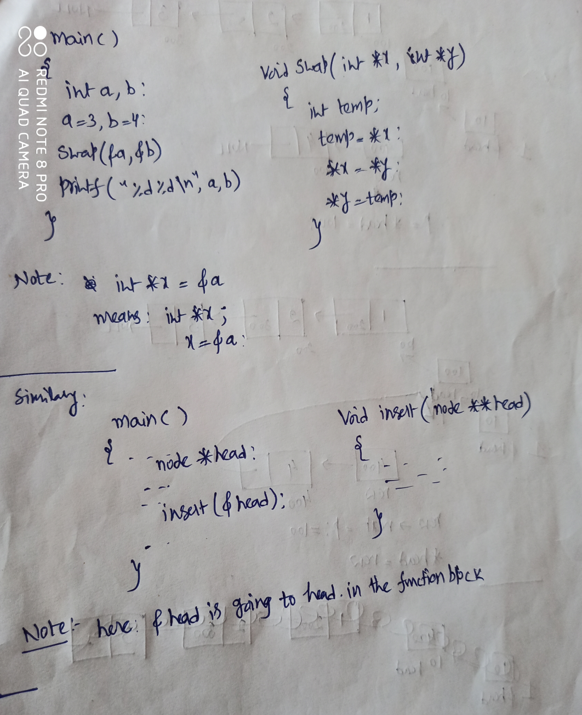
3
4
a
b
4
3
a
b
Note:
1. When you write (int *x) there are two variables
Associated one is (x) and another is (*x)
2. When you write (int **x) there are three
variables associated one is (x) and another is (*x)
and (**x)
CS201
Data Structures
‹#›

Slide 37
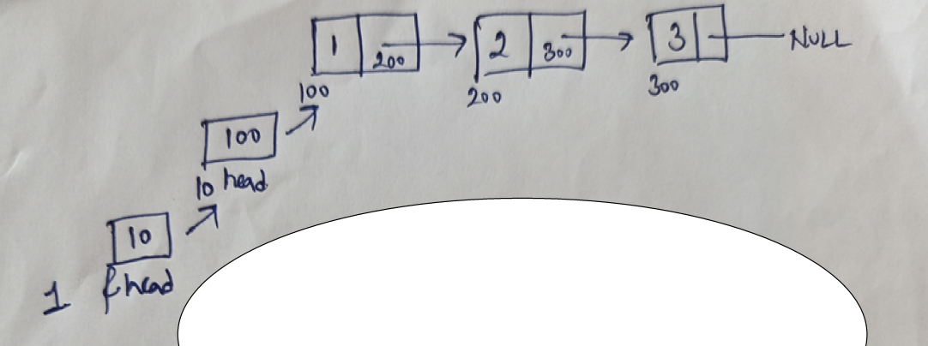
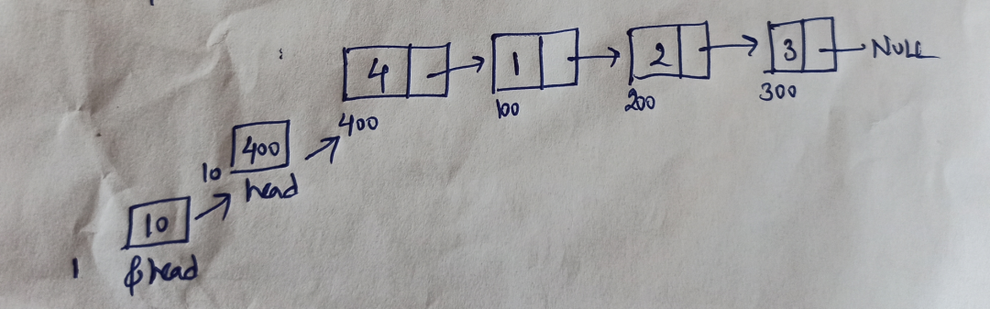
Insert at the begining
Input:
Output:
Insert 4 at begining
CS201
Data Structures
‹#›

Slide 38
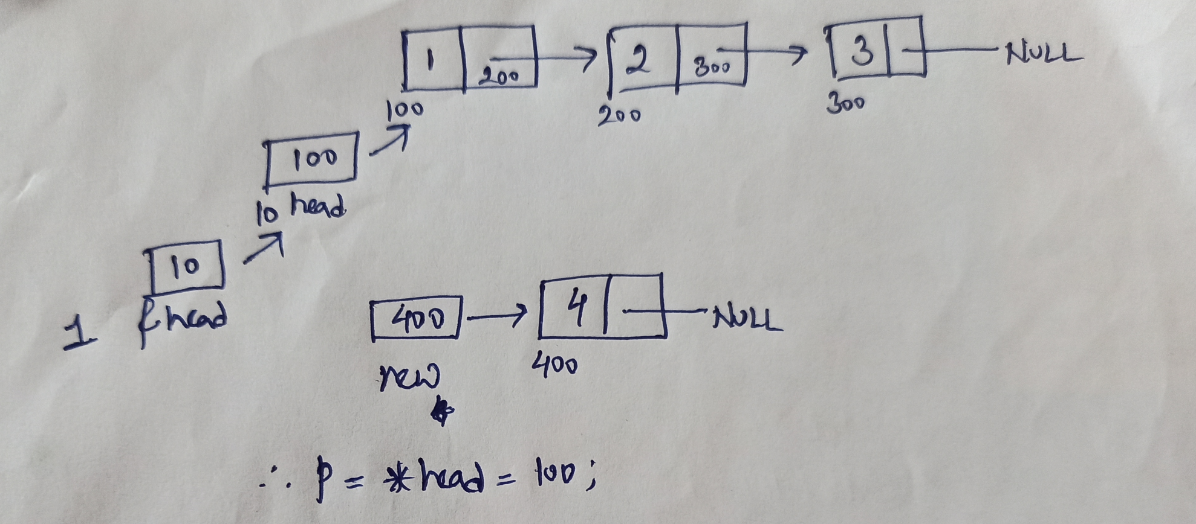
Insert at begining
Means *m =100
CS201
Data Structures
‹#›

Slide 39
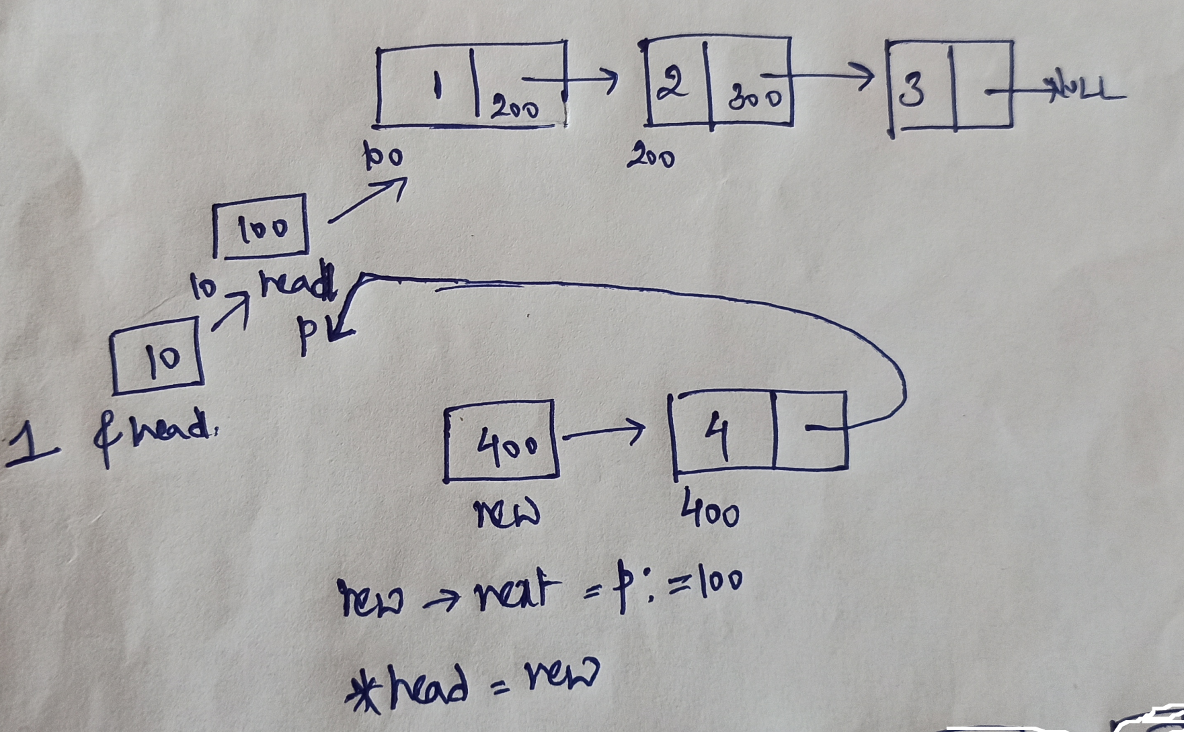
Insert at begining
*m
m
CS201
Data Structures
‹#›

Slide 40
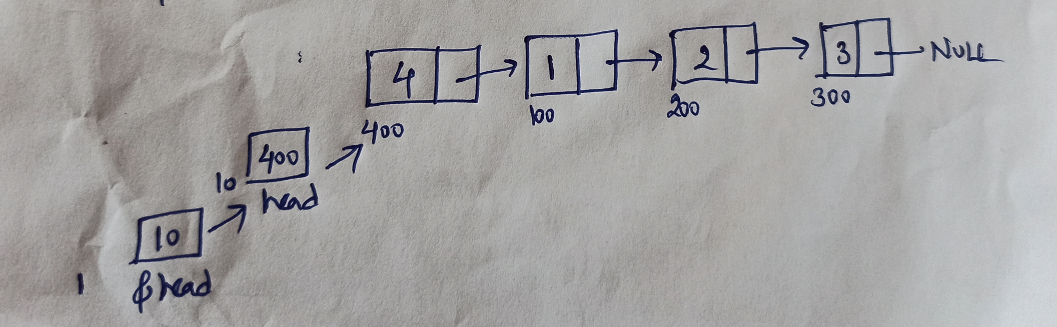
Insert at begining
CS201
Data Structures
‹#›

Slide 41
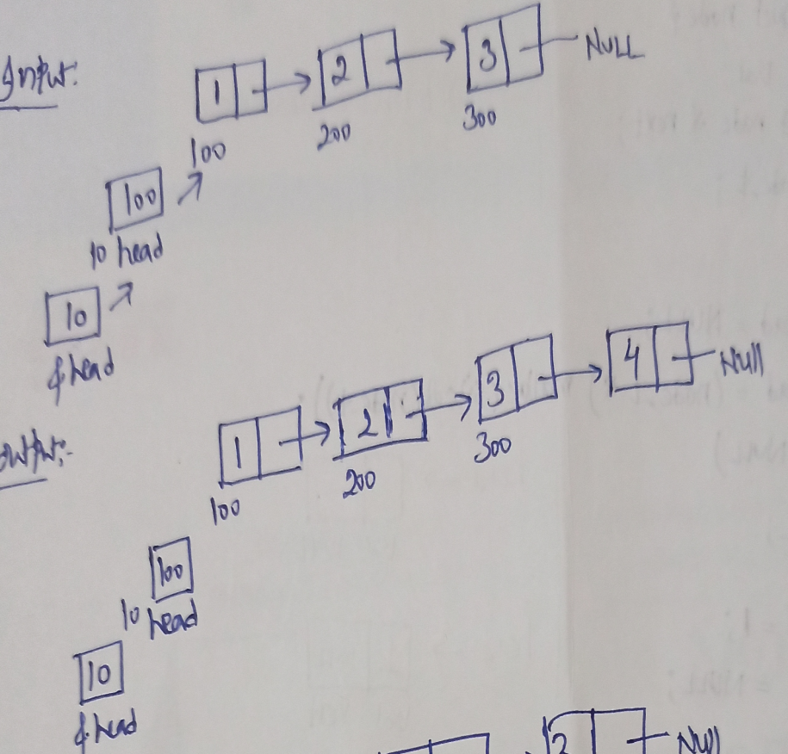
Insert at the end(p=Null)
None of the roll numbers
are matching…
when p=Null while loop breaks
CS201
Data Structures
‹#›

Slide 42
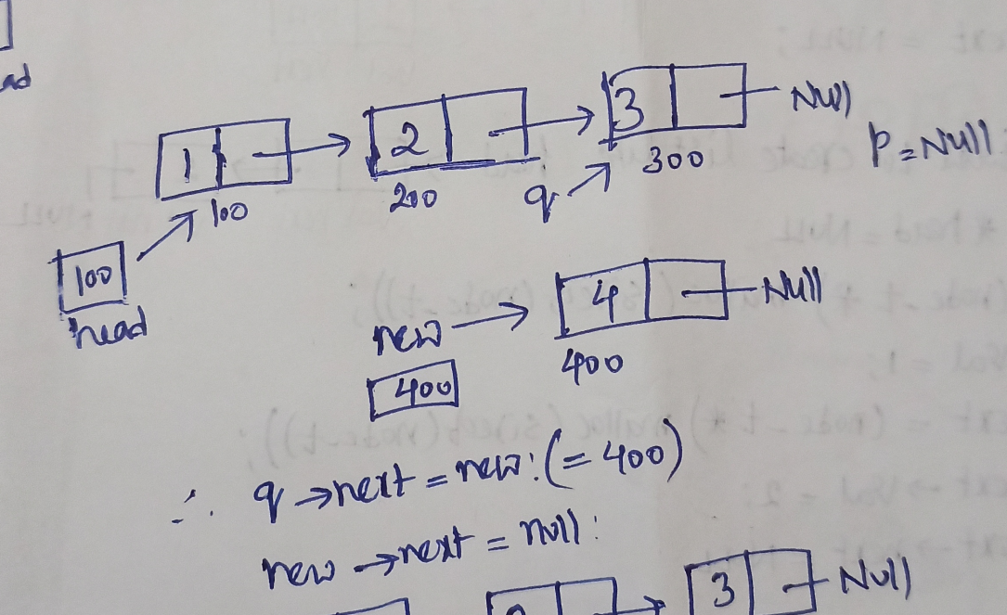
Suppose roll number 4 to be
Inserted before roll number 3…
P->rollnumber ==3 then
While loop breaks
Note: q contains 300
CS201
Data Structures
‹#›

Slide 43
Insert in middle
Input
1 | 200
2 | 300
3 | Null
100
200
300
100
head
Output
1 | 200
2 | 400
4 | 300
3 | Null
100
200
400
300
100
head
CS201
Data Structures
‹#›
CS201
Data Structures
‹#›

Slide 44
Output
1 | 200
2 | 300
3 | Null
100
200
300
100
200
300
head
q
p
4 | Null
q->next = new=400
400
new->next = p=300
400
new
CS201
Data Structures
‹#›

Slide 45
Deleting a node from the list
CS201
Data Structures
‹#›

Slide 46
What is to be done?
Here also we are required to delete a specified node.
Say, the node whose roll field is given.
Here also three conditions arise:
Deleting the first node.
Deleting the last node.
Deleting an intermediate node.
CS201
Data Structures
‹#›

Slide 47
void delete (node **head)
{
int rno;
node *p, *q;
printf ("\nDelete for roll :");
scanf ("%d", &rno);
p = *head;
if (p->roll == rno)
/* Delete the first element */
{
*head = p->next;
free (p);
}
CS201
Data Structures
‹#›

Slide 48
else
{
while ((p != NULL) && (p->roll != rno))
{
q = p;
p = p->next;
}
if (p == NULL) /* Element not found */
printf ("\nNo match :: deletion failed");
else if (p->roll == rno)
/* Delete any other element */
{
q->next = p->next;
free (p);
}
}
}
CS201
Data Structures
‹#›

Slide 49
Problem on linkedlist
a | 200
c | 300
d | 400
e | 300
100
200
300
400
100
p
printf(“%c”, p->link->link->link->link->data)
100
200
300
400
300
d
CS201
Data Structures
‹#›

Slide 50
References
1. https://cse.iitkgp.ac.in/pds/semester/2016a/
CS201
Data Structures
‹#›
Notes:
‹#›

